Slide 1
Submitted By : Muhammad Yasir Hassan 2021-CS-28
Student Management System

Slide 2
Project Description
The system designed includes:
The manual system used by the Computer Science Department at UET Lahore must be automated as part of this project using a desktop application
Attendance is tracked on a specific date.
Clo's were added, along with their corresponding Rubrics and Rubric Levels.
Students are evaluated in accordance with the Rubric & Clo's appended. The assessments and their components are used to evaluate students, and each evaluation results in a record of the student's performance
Records must be retained in accordance with dates
PDF reports providing important information for the department were also produced using iTextSharp.

Slide 3
Project Features
User will be able to add , delete update student and while deleting student their evaluted marks as well as attendence will also be deleted.
User will be able to Mark Attendance Of every Student at any date
User will be able to add CLO's and their respective Rubric and Rubric level
User will be able to add Assessment and their respective Assessment Component
User will be able to Mark evaluation according to the Rubric and Assessment & their components
Reports can also be generated in PDF Form

Slide 4
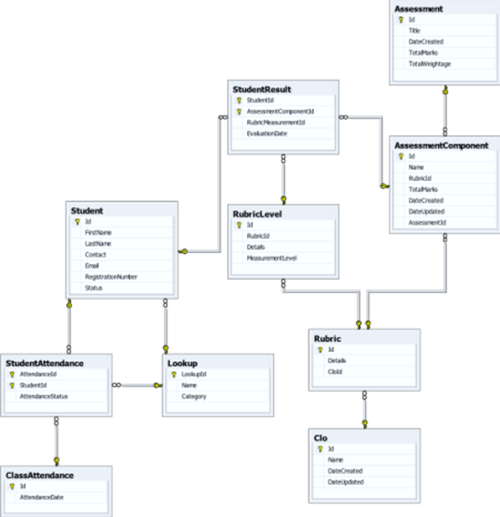
Student Management System
Database Diagram Showing Relations

Slide 5
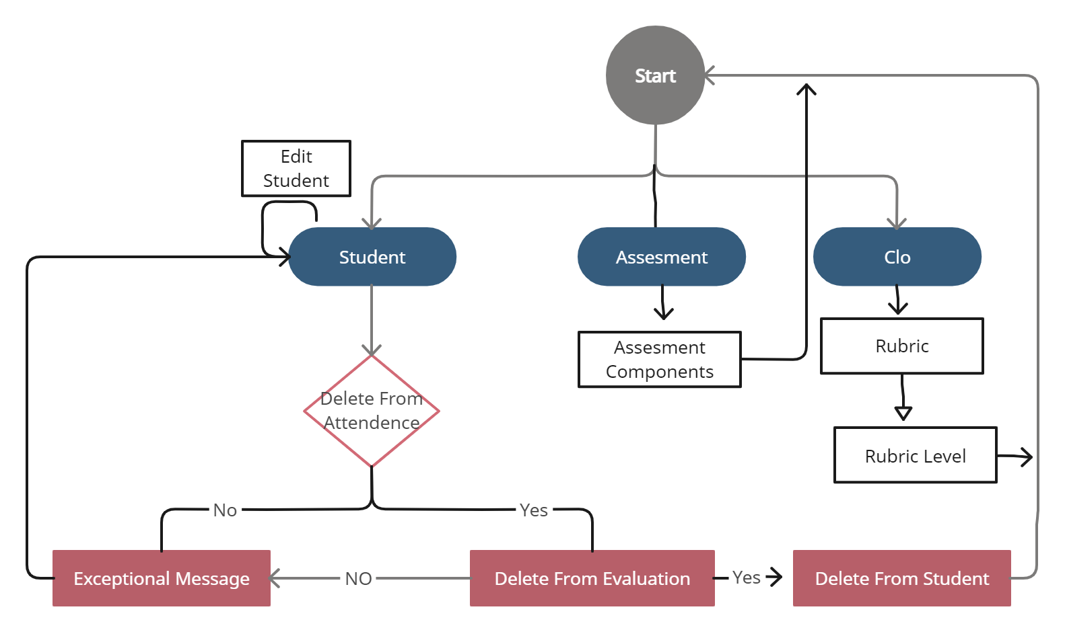
Student Management System
UML DAIGRAM OF THE PROJECT

Slide 6
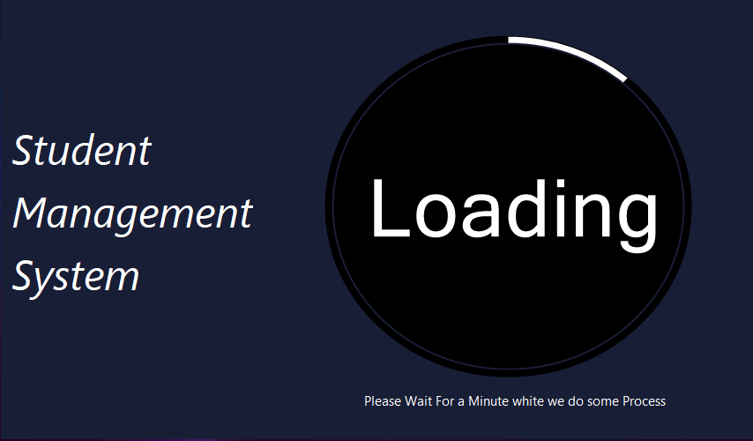
Student Management System​
​
​
User Interfaces
Splash Screen

Slide 7
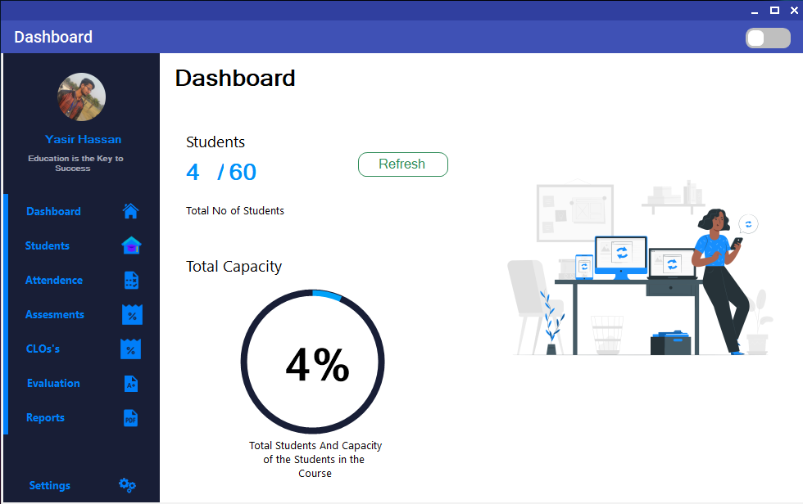
Student Management System
USER INTERFACES – Dashboard

Slide 8
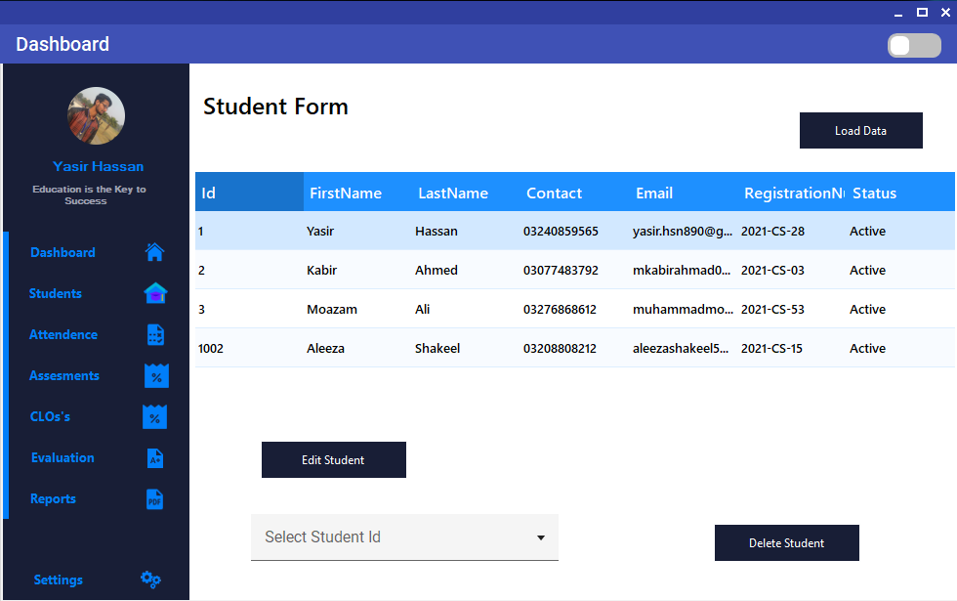
Student Management System
USER INTERFACES – View & Delete Student Form

Slide 9
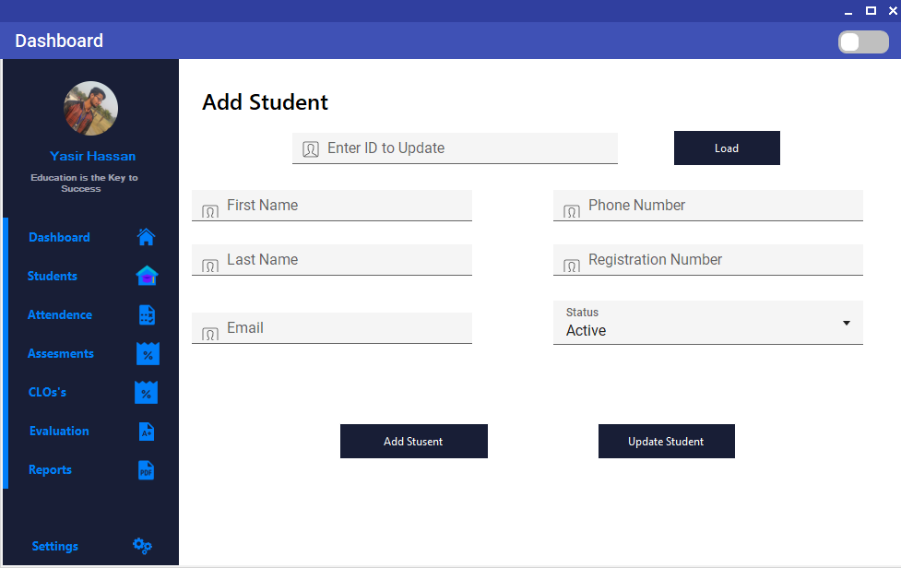
Student Management System
USER INTERFACES – Add & Update Student Form

Slide 10
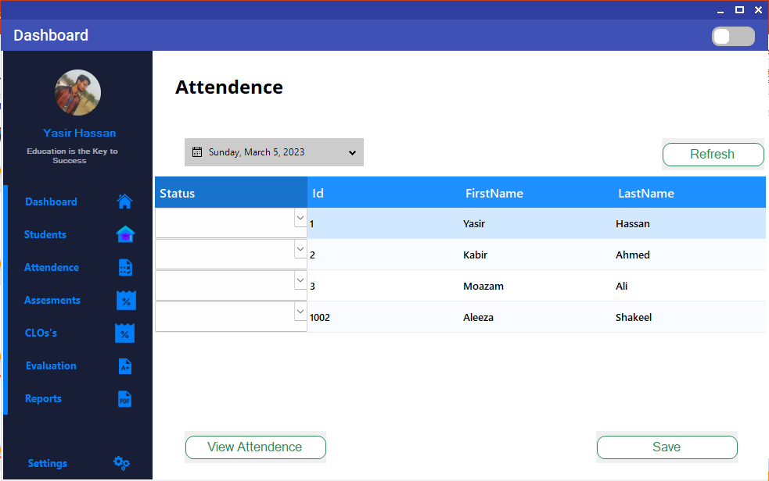
Student Management System
USER INTERFACES – Mark Attendence Form

Slide 11
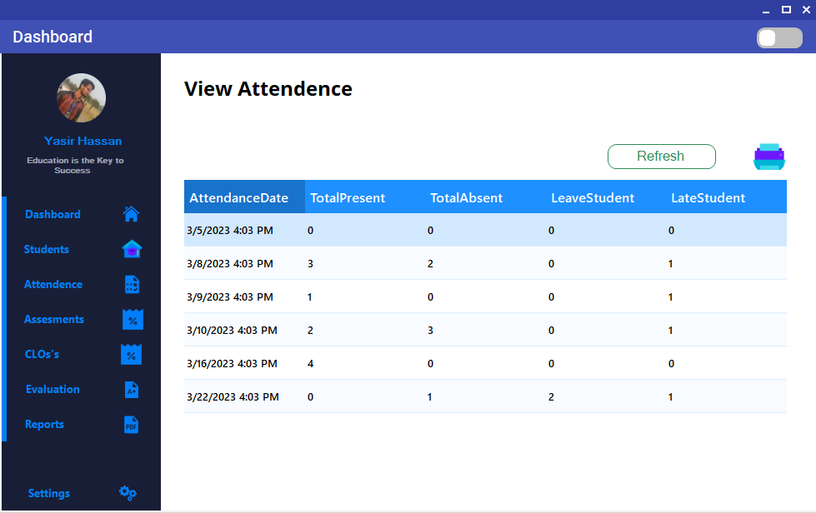
Student Management System
USER INTERFACES – View Attendance Form

Slide 12
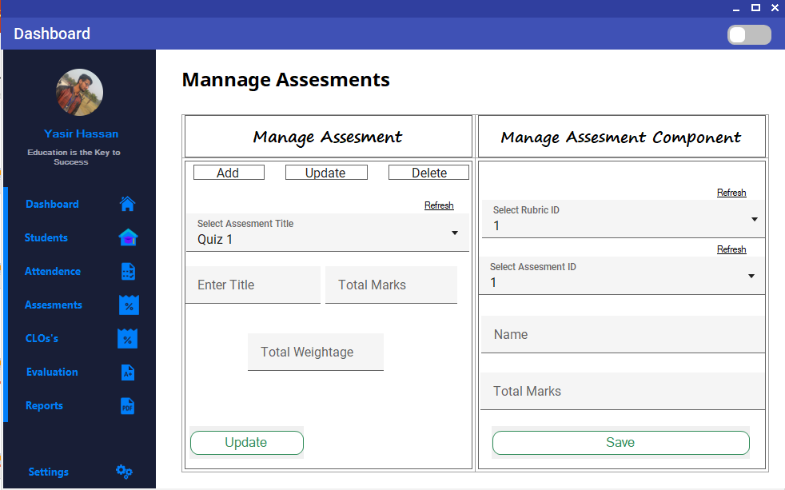
Student Management System
USER INTERFACES –ADD / Update & Delete Assessment / Assessment Components

Slide 13
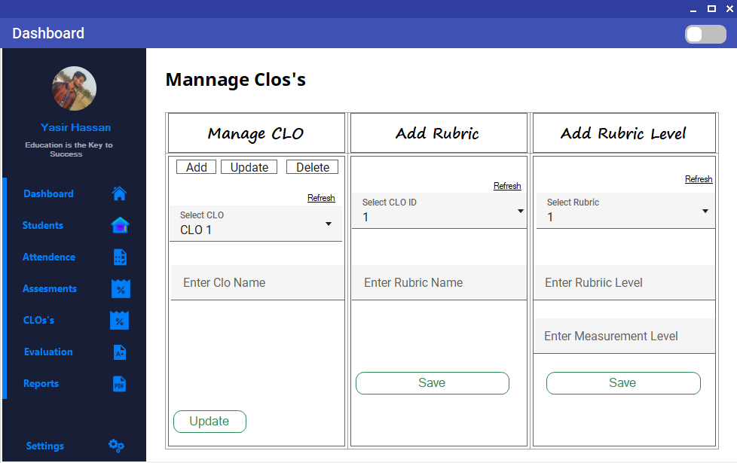
Student Management System
USER INTERFACES –Manage CLO / Rubric / Rubric Level

Slide 14
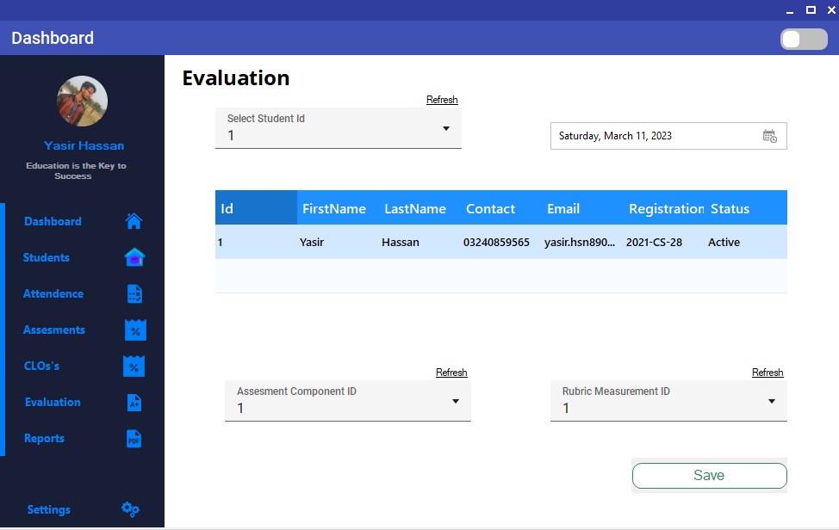
Student Management System
USER INTERFACES – Evaluation Form

Slide 15
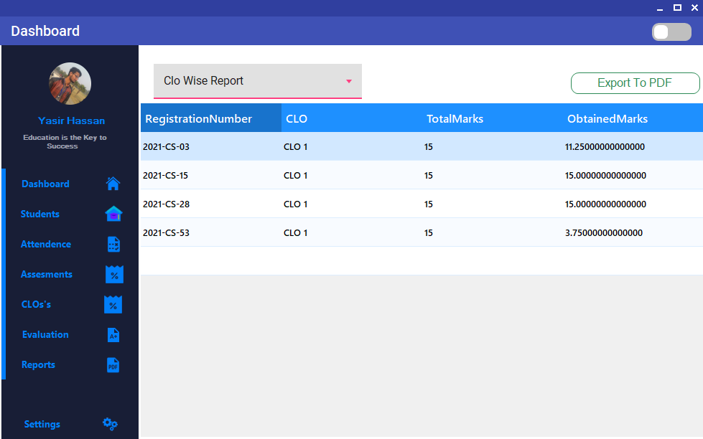
Student Management System
USER INTERFACES – Report Generation Form

Slide 16
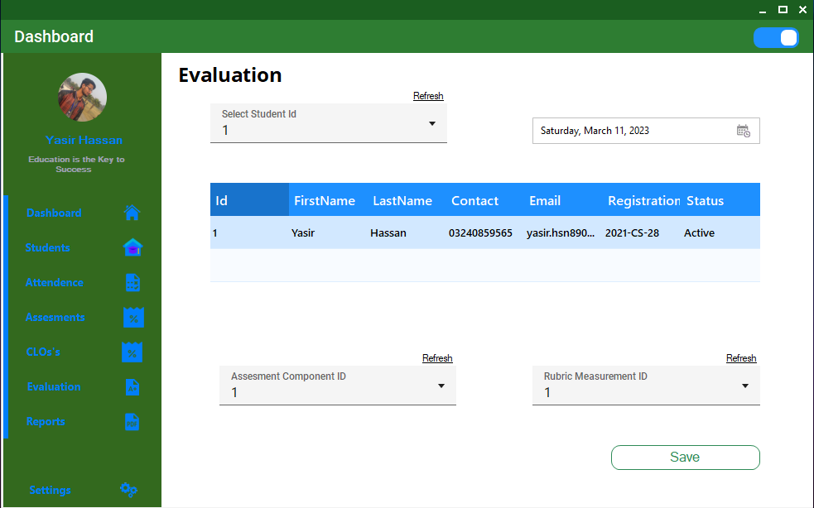
Student Management System
USER INTERFACES – Theme Changing Button

Slide 17
Student Management System
Email Sending
Email Will be sent to all students when their attendance will be marked with the time and date of the attendance

Slide 18
Student Management System
PDF Reports
Assessment Wise Report
Assessment Component Wise Report
Clo Wise Report
Total Result Report
Attendence Report

